Slide 1
report

Slide 2
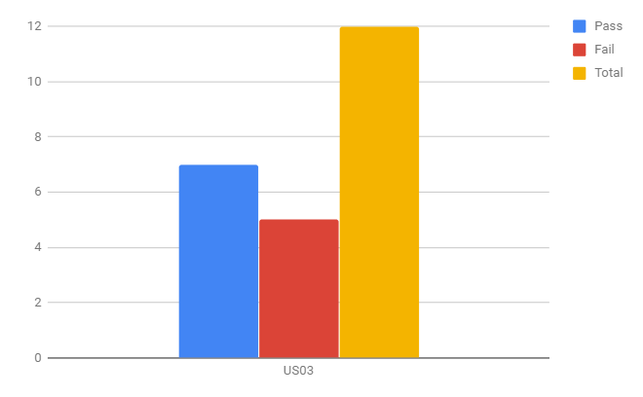
Test cases Execution status

Slide 3
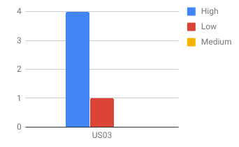
Defect analysis per severity

Slide 4
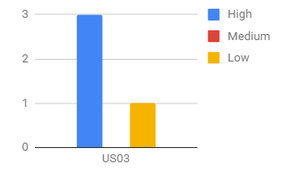
Defect analysis per periority

